Slide 1

Basic Details of the Team and Problem Statement
Organization Name: Government of Punjab
PS Code: SIH25016 Problem Statement Title : Automated Student Attendance Monitoring and Analytics System for Colleges
Team Name: Iris Scan
Team Leader Name: Omkar Vilas Sarpane Institute Code (AISHE):C-34508 Institute Name: TPCT’s College of Engineering, Dharashiv
Theme Name: Smart Education

Slide 2

Acadix Scan
AI-Powered Face Recognition Attendance System
Team:- Iris Scan

Slide 3

The Challenge of Manual Attendance
Time-Consuming Process
Human Error Prone
Proxy Attendance
Traditional roll calls waste valuable class time and disrupt learning flow.
Manual marking leads to mistakes, missed entries, and inconsistent records.
Students can easily mark attendance for absent classmates, compromising accuracy.
Universities need an automated, accurate, and secure solution for modern education.

Slide 4

Introducing Acadix Scan
Intelligent Automation
A sophisticated desktop application built with Python that revolutionises attendance marking through real-time facial recognition technology.
Seamlessly integrates AI-powered identification with user-friendly interfaces for both students and administrators.

Slide 5
Key Objectives
01
02
Secure Role-Based System
Robust Recognition Pipeline
Develop distinct access levels for students and administrators with robust authentication.
Implement accurate facial identification technology for reliable attendance marking.
03
04
Intuitive User Interface
Persistent Record Management
Create user-friendly graphical interfaces that enhance the overall experience.
Maintain comprehensive and manageable student attendance databases.

Slide 6
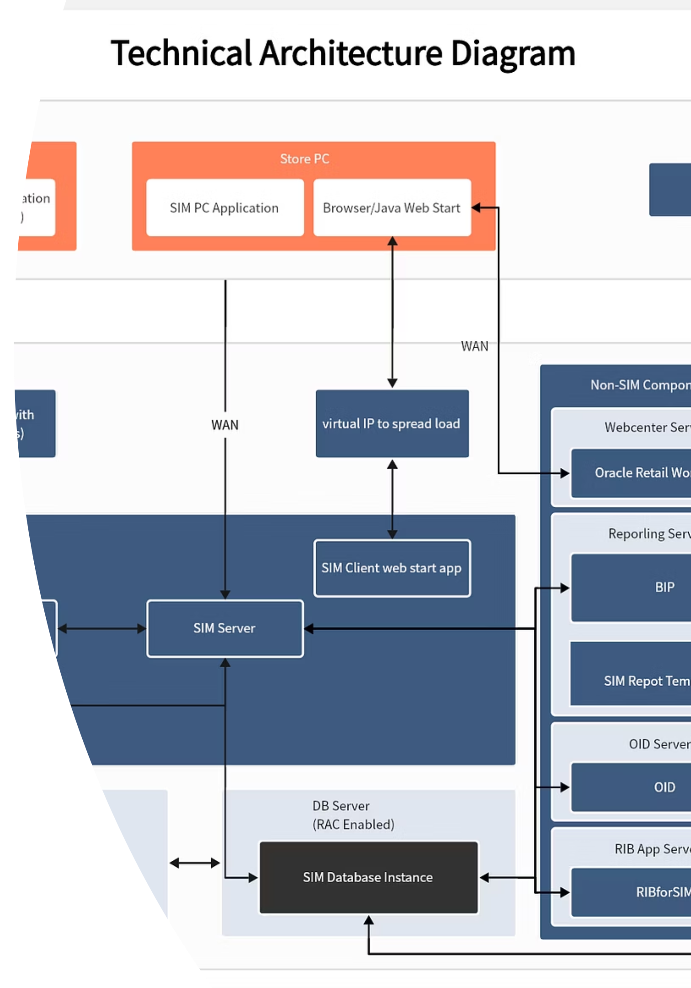



System Architecture
Frontend (UI Layer)
Built with PyQt5 for seamless user interaction and intuitive navigation.
Backend (Logic Layer)
Core Python scripts managing authentication, data processing, and facial recognition.
Data Persistence Layer
Pandas DataFrames with CSV files for lightweight, efficient data storage.

Slide 7




Technology Stack
Python 3
PyQt5 Framework
Core programming language providing robust functionality and extensive library support.
Professional GUI development for creating intuitive desktop applications.
Pandas & OpenCV
CSV Storage
Data manipulation and computer vision libraries for efficient processing.
Lightweight local file system for reliable data persistence and portability.

Slide 8

Dual-Role System Features
Student Portal
Administrator Dashboard
Secure signup with password hashing
Secure admin authentication
Password recovery via security questions
Live face recognition for class attendance
Personal dashboard with attendance status
Comprehensive student management
Face model training using IP Webcam
Attendance log viewer with editing
Profile information updates
Data export (Excel, CSV, PDF)

Slide 9
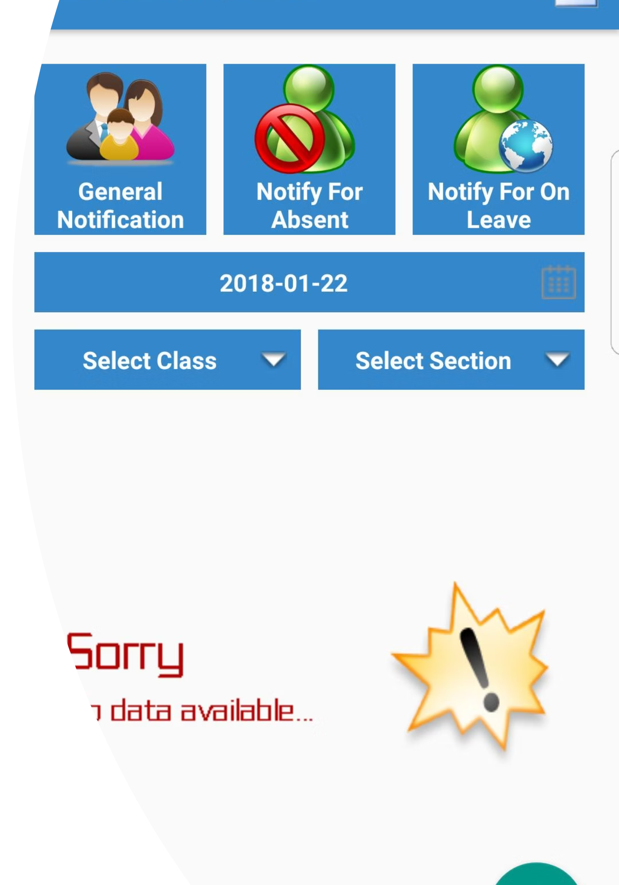
Proactive Alert System
01
02
Automatic Detection
Instant Notification
System monitors attendance and triggers alerts when dropping below 75% threshold
Automated alerts sent simultaneously to student and parent via phone/email
03
Early Intervention
Enables timely communication and proactive support from faculty and parents

Slide 10

Student Attendance Analytics
Present
Absent
Visual representation helps students quickly understand their attendance patterns and identify areas needing improvement

Slide 11
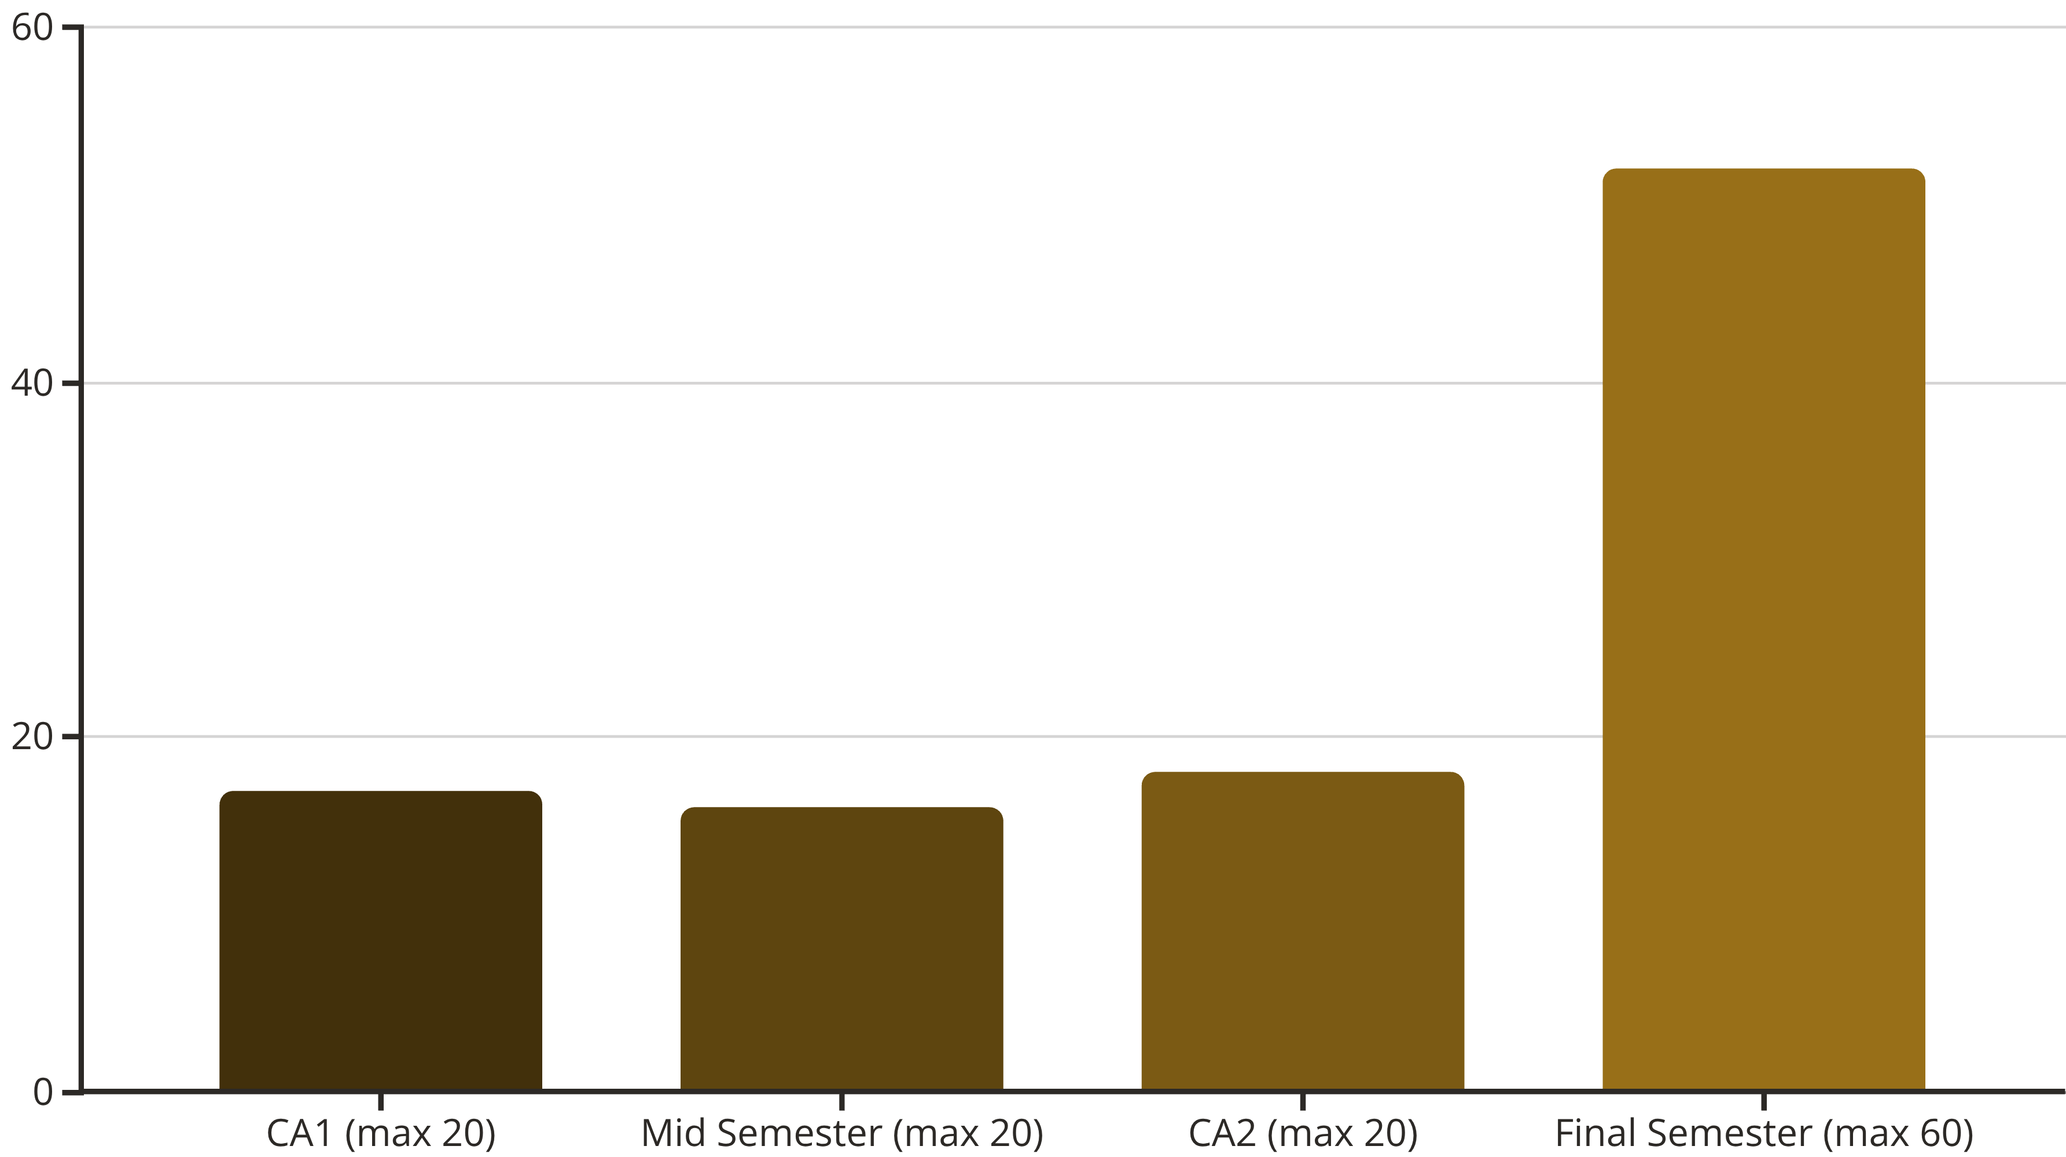
Academic Performance Tracking
Students can visualize their performance curve across different assessments, identifying strengths and improvement areas. This chart reflects a marking distribution where CA1, Mid Semester, and CA2 are each out of a maximum of 20 marks, while the Final Semester is out of a maximum of 60 marks.

Slide 12






System Impact Across Stakeholders
For Institutions
For Students
For Parents
360-degree view of student engagement and performance, enabling data-driven decisions and improved outcomes
Powerful self-assessment tools for tracking progress and taking ownership of academic journey
Direct automated communication channel to stay informed about their child's academic progress

Slide 13

Face Recognition Pipeline
1
Data Collection
Students capture multiple face images using IP Webcam for training dataset creation.
2
Model Training
System processes images to create unique facial embeddings and trains recognition model.
3
Real-time Recognition
Live video feed analysis compares detected faces against trained models for matching.
4
Attendance Marking
Successful matches automatically mark students present, preventing duplicate entries.

Slide 14
User Interface Showcase
Professional Splash Screen
Intuitive Login System
Informative Dashboards
Creates an impressive first impression with modern branding and smooth loading experience.
Streamlined authentication with clear role selection for seamless user navigation.
Tailored views providing relevant information and controls for different user types.

Slide 15

Project Success & Future Vision
Achievements
Successfully delivered a fully functional, secure, and user-friendly attendance system that meets all project objectives.
Future Enhancements
Cloud integration for scalable data storage
Web and mobile application development
Liveness detection for enhanced security
Advanced analytics and reporting features
Thank you for your attention. Questions welcome!

Slide 16
Team Member Details
Team Leader Name: Omkar Vilas Sarpane
Branch (B.Tech) Stream (CSE) Year (III)
Team Member 1 Name: Harsh Balaji Bangad
Branch (B.Tech): Stream (CSE) Year (III)
Team Member 2 Name: Manisha Ashok Poul
Branch (B.Tech) Stream (CSE) Year (Iii)
Team Member 3 Name: Geeta Katti
Branch (B.Tech) Stream (CSE) Year (III)
Team Member 4 Name: Priti Maruti Biradar
Branch (B.Tech) Stream (CSE) Year (III)
Team Member 5 Name: Rohit Prabhkar Bhore
Branch (B.Tech) Stream (AI&DS) Year (III)

